Slide 1
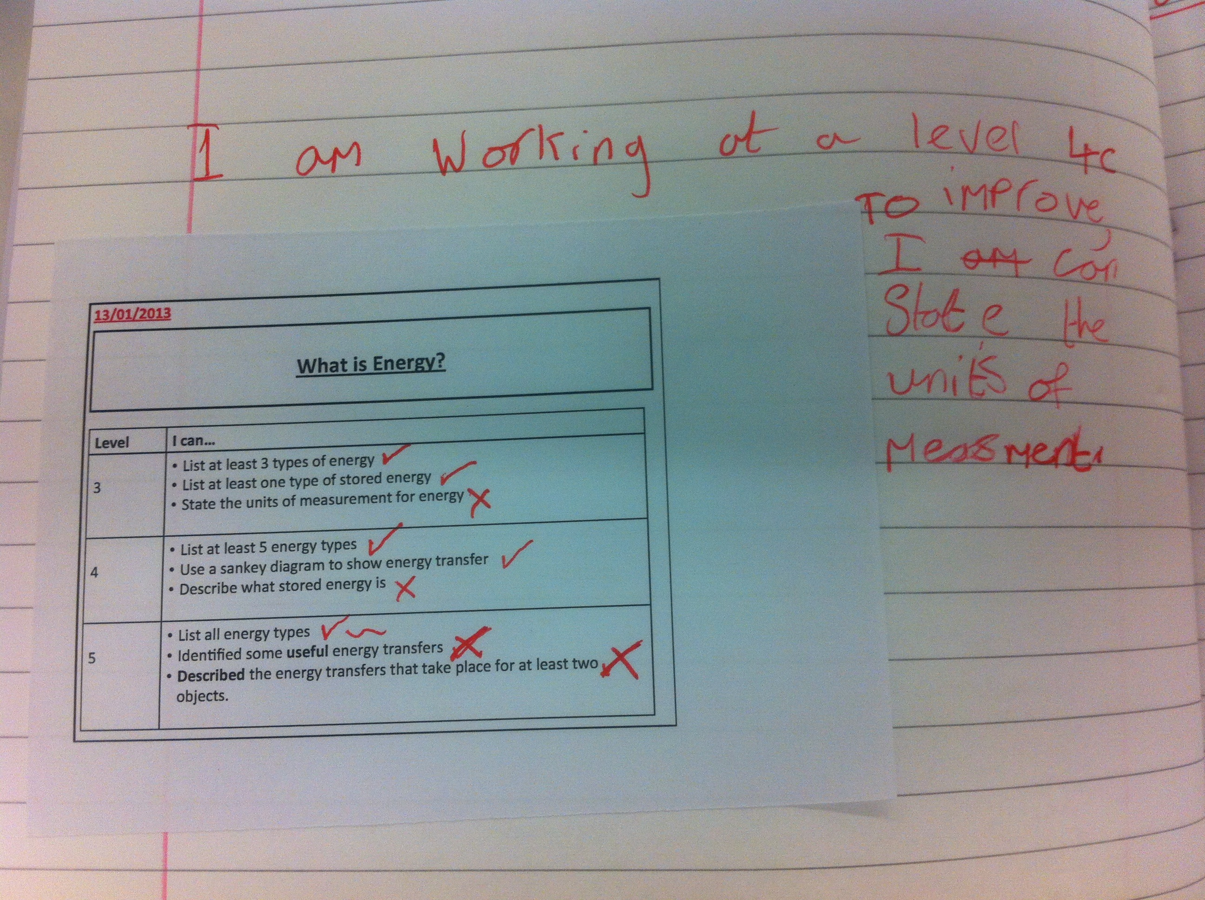
Afl Strategy
Using level ladders for peer/self assessment

Slide 2
The CLASS
Science - 7B5
I chose to conduct the project with my bottom set year 7 class.
Pupils in the class are of very low ability and I had observed during the first term that students were struggling to show progression in their work and raise their levels.
I thought it would be interesting to observe the impact of introducing a new self/peer assessment strategy to the class, which would allow pupils to be more aware of their own levels and current achievement, allowing them to set targets for their own development.

Slide 3
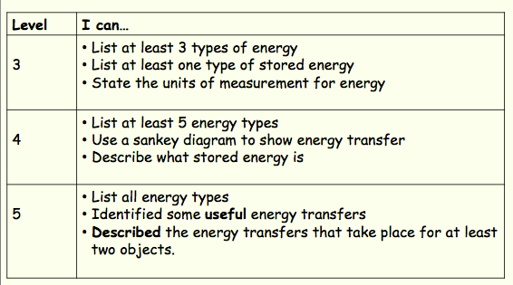
THE STRATEGY – LEVEL LADDERS
Pupils are given a set of leveled objectives at the start of the lesson
2) At the end of the lesson, as either self/peer assessment, some time is given for pupils to firstly assess the level they have achieved during the lesson, using the ladder to write a sentence stating the reasons why, or to tick off on the ladder what they are able to achieve
3) Pupils then use the level ladder to identify and write a sentence explaining exactly what they must do in order to improve and progress

Slide 4
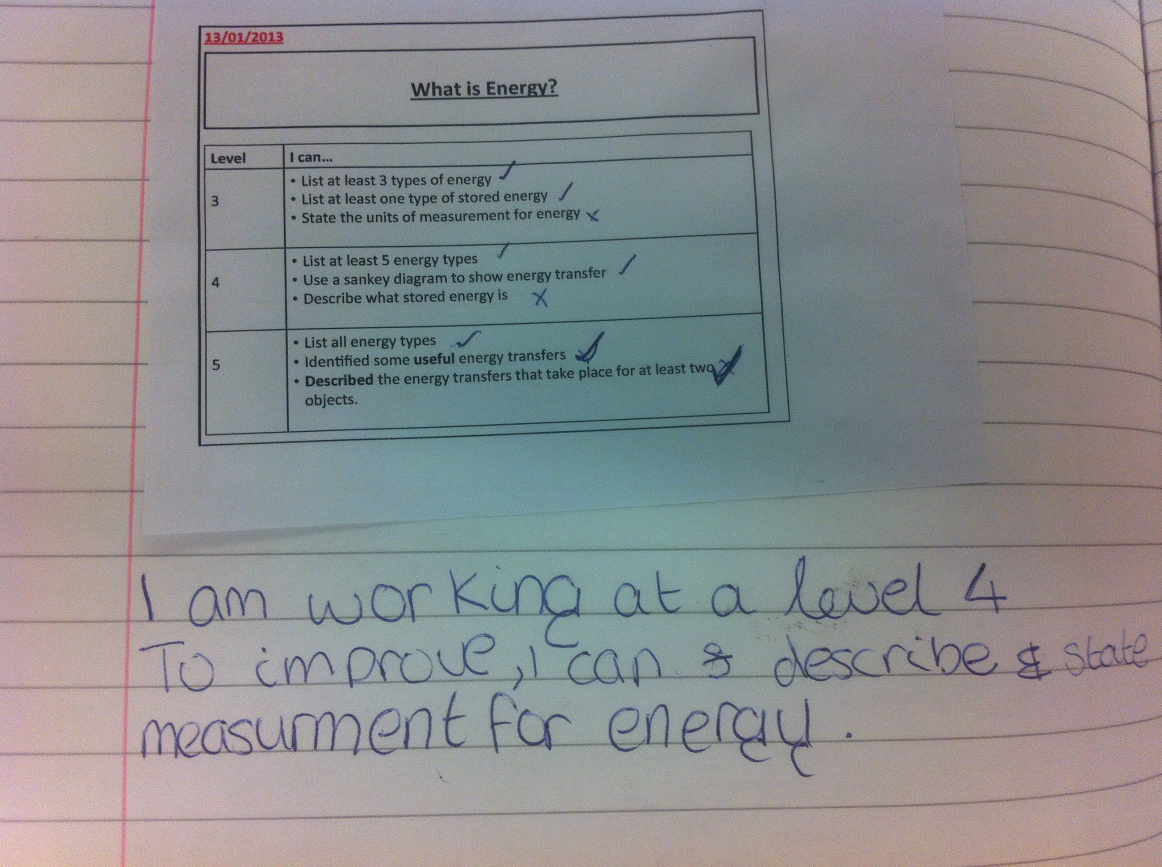
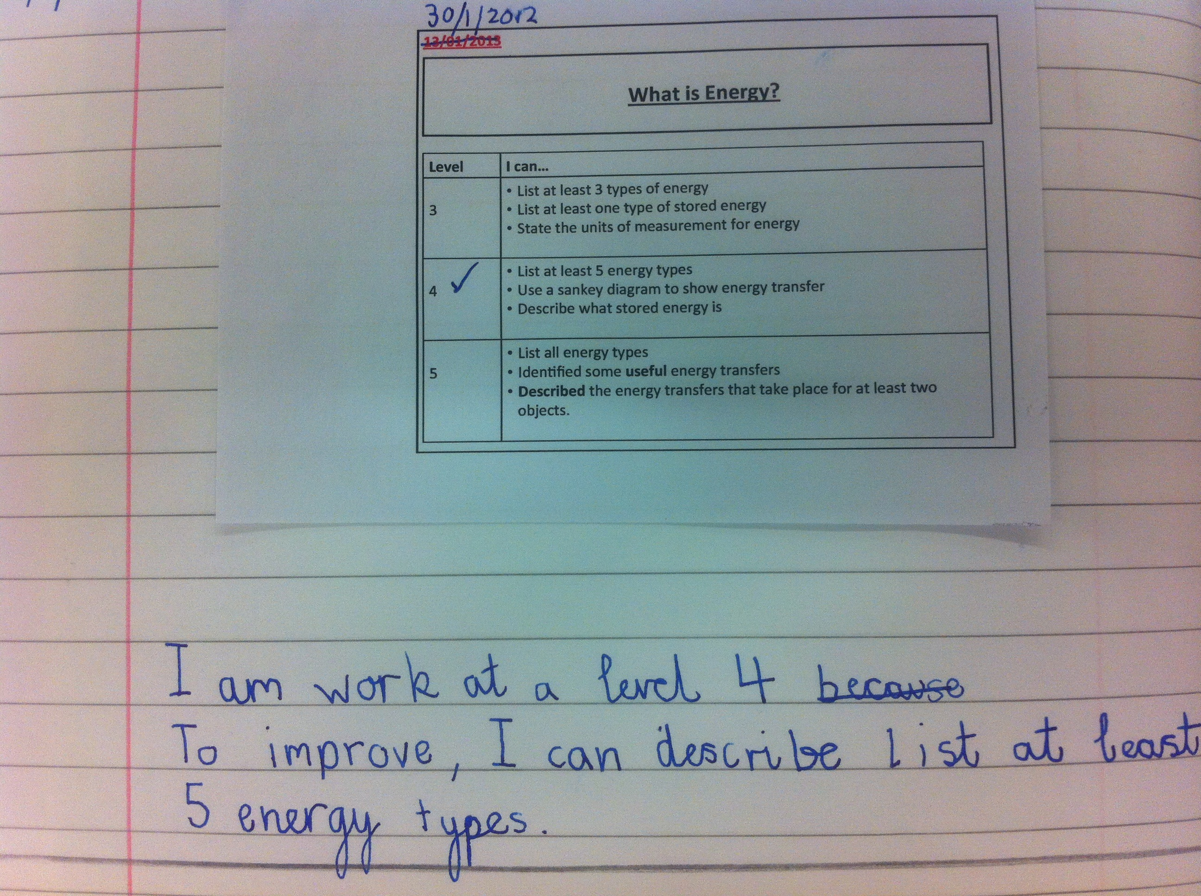
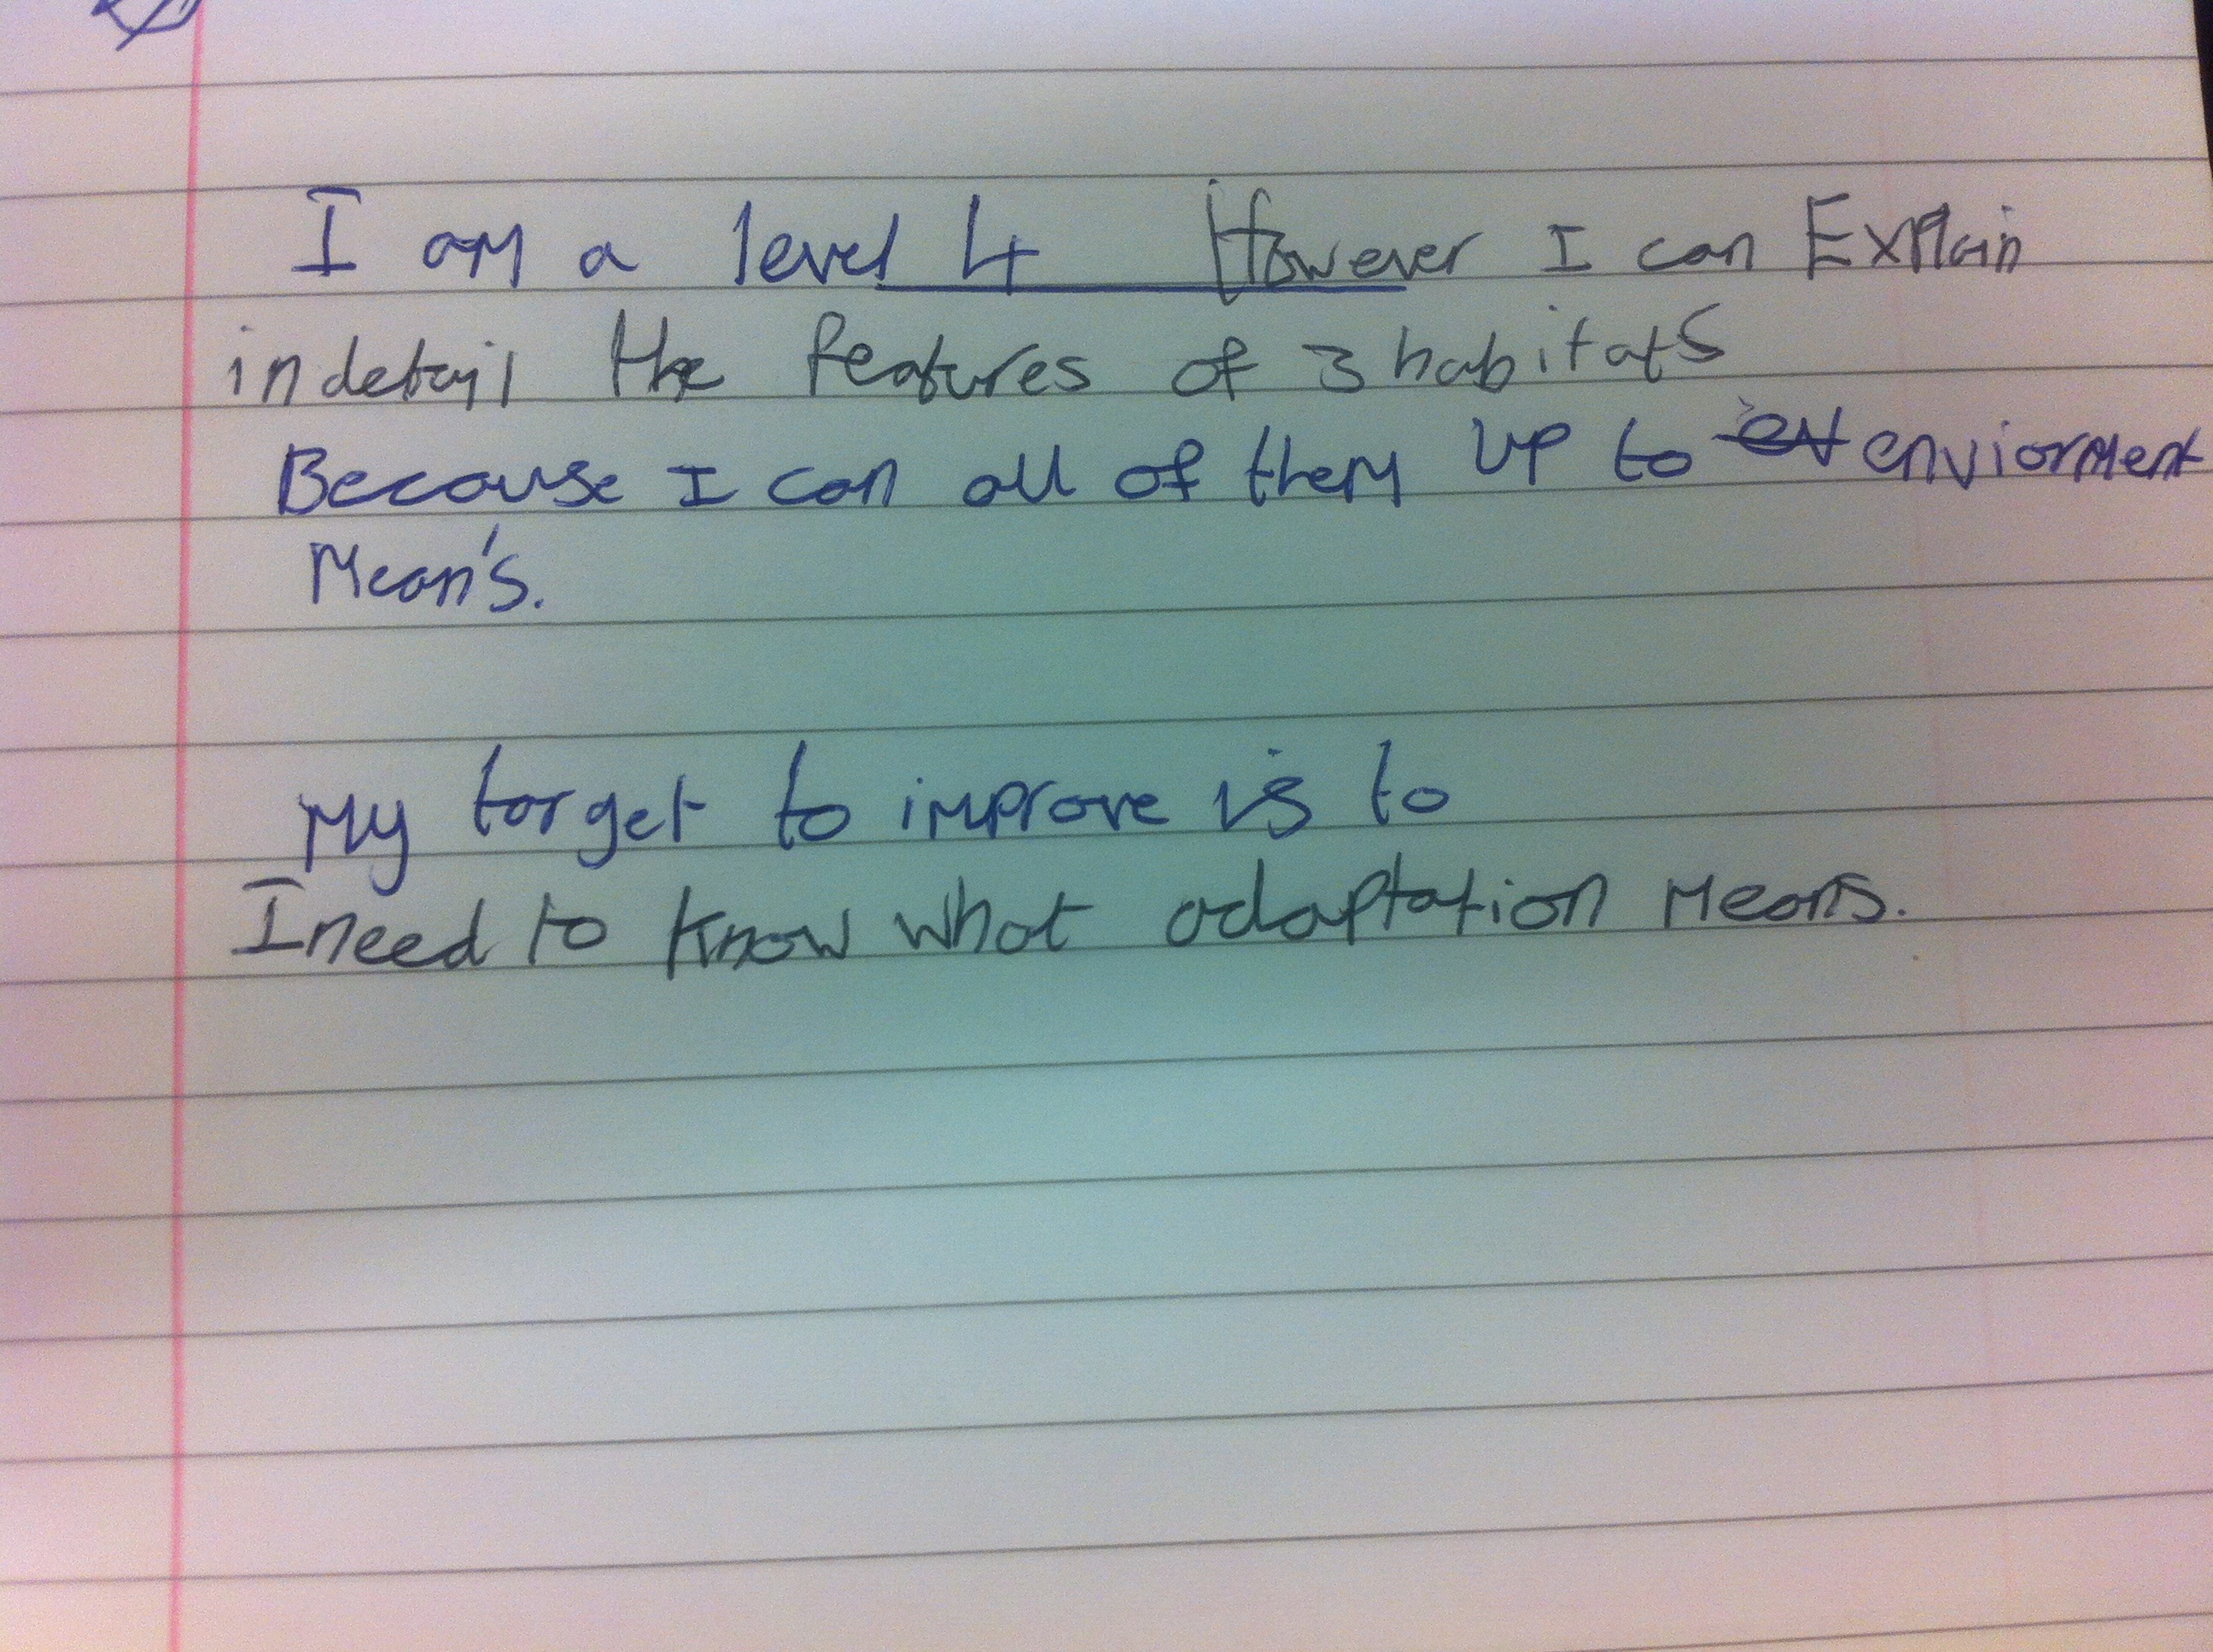
EXAMPLES of pupil work…

Slide 5
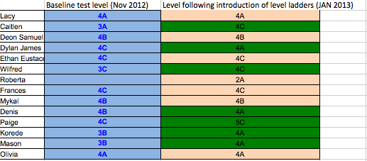
Findings
All pupils have benefited from the use of the strategy, explaining that it has allowed them to more easily visualise what they are trying to achieve.
It has also provided students with instant and regular feedback of how they are progressing.
Furthermore, the strategy is developing the key skill of self assessment as pupils are now taking more responsibility for their own learning, and are provided with an awareness of how they can then extend their learning.
In addition, the number of pupils maintaining/progressing in their attainment levels since the implementation of the strategy supports the use in raising pupil attainment:

